Slide 1
Group 4
Bellamy Woo Zhen Yu (2301579) Chai Ze Xuan (2301629)
Shaun Ong Zhi Peng (2301632)
Muhammad Ariff (2301644)
Low Min Wei (2301555)

Slide 2

01
Design

Slide 3
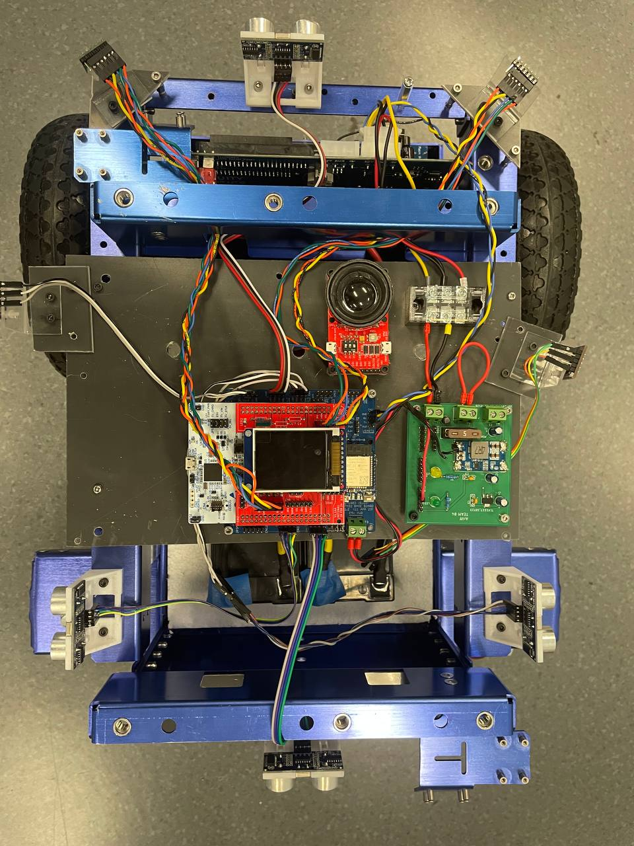
Design
Ultrasound
ToF Sensor
ToF Sensor
Light Module
Light Module
Light Module
STM, Mezzanine, LCD, Baseboard
PDB Board
Ultrasound
Ultrasound
Ultrasound

Slide 4
02
Navigation Algorithm

Slide 5

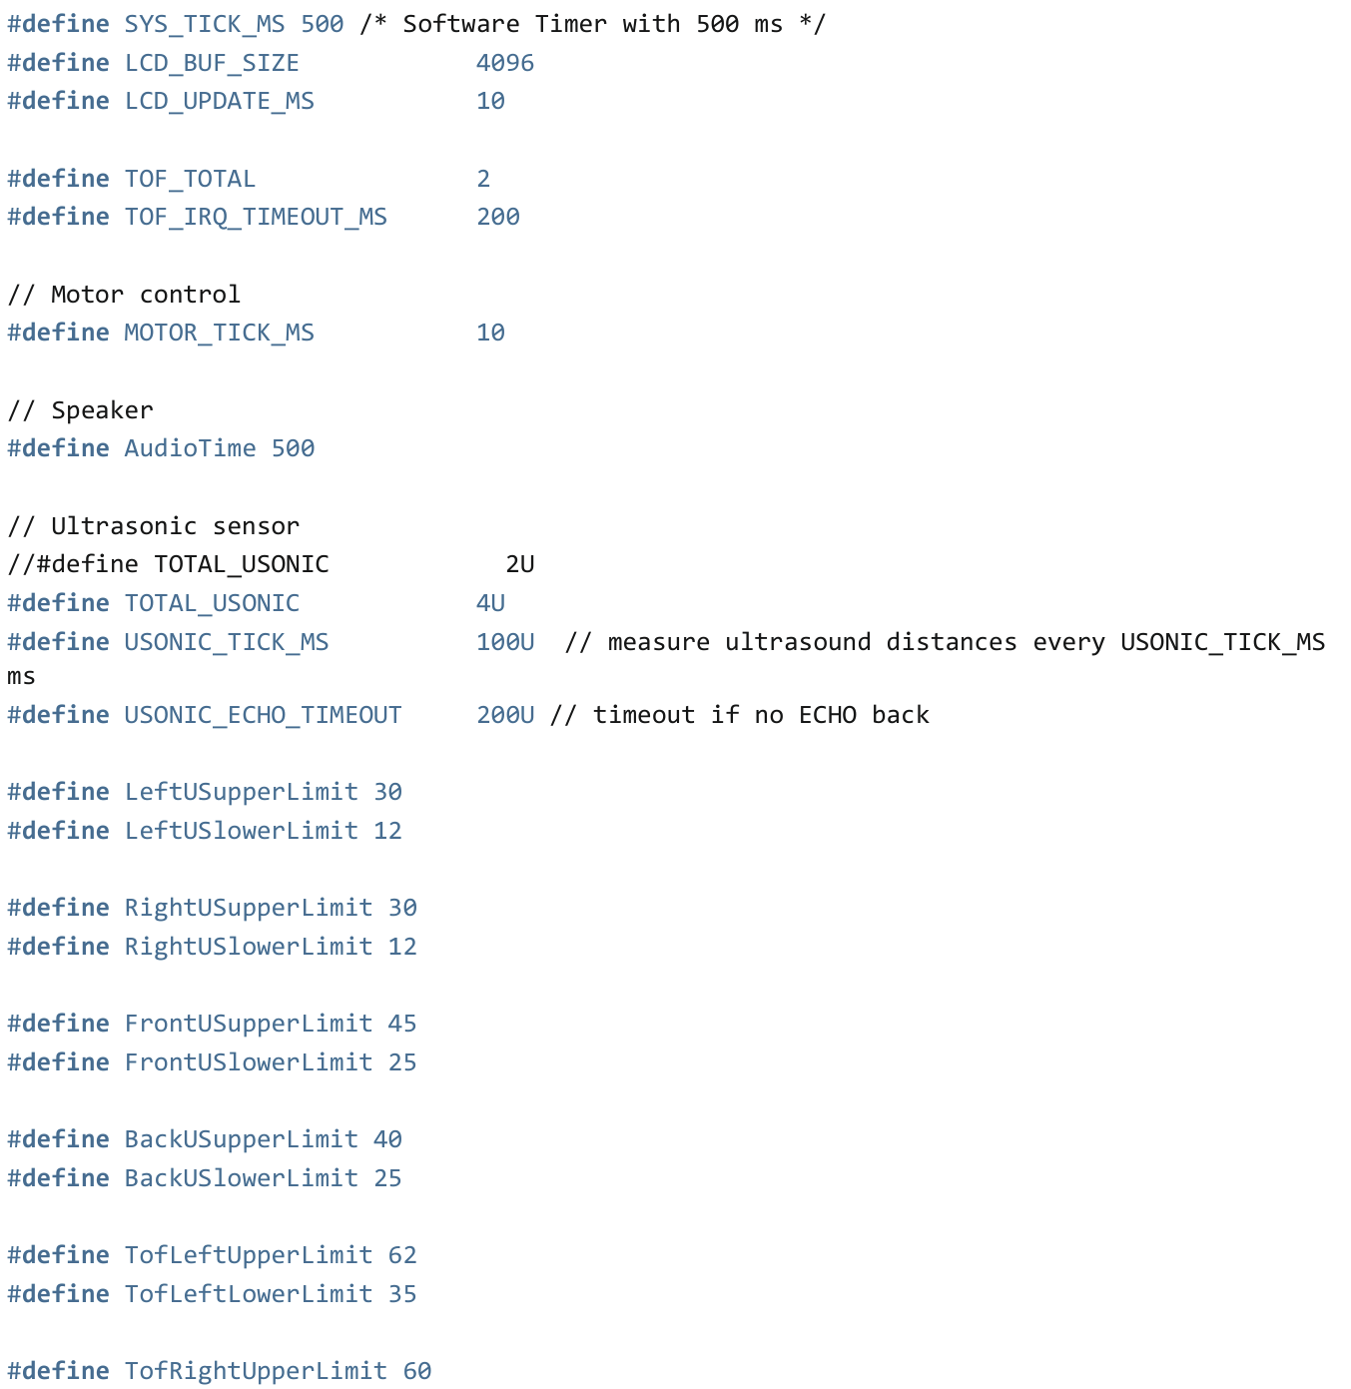
Main Control Flags and Threshold Values
mode: Determines whether the robot is in manual or autonomous mode.
Obstacle: Counter for obstacles in autonomous mode.
MoveFront: Indicates if the robot should move forward in autonomous mode.
TurnLeft: Indicates if the robot should turn left in autonomous mode.
TurnRight: Indicates if the robot should turn right in autonomous mode.
STOP: Indicates if the robot should stop in autonomous mode.
RotateRight: Indicates if the robot should rotate right in autonomous mode.
RotateLeft: Indicates if the robot should rotate left in autonomous mode.

Slide 6
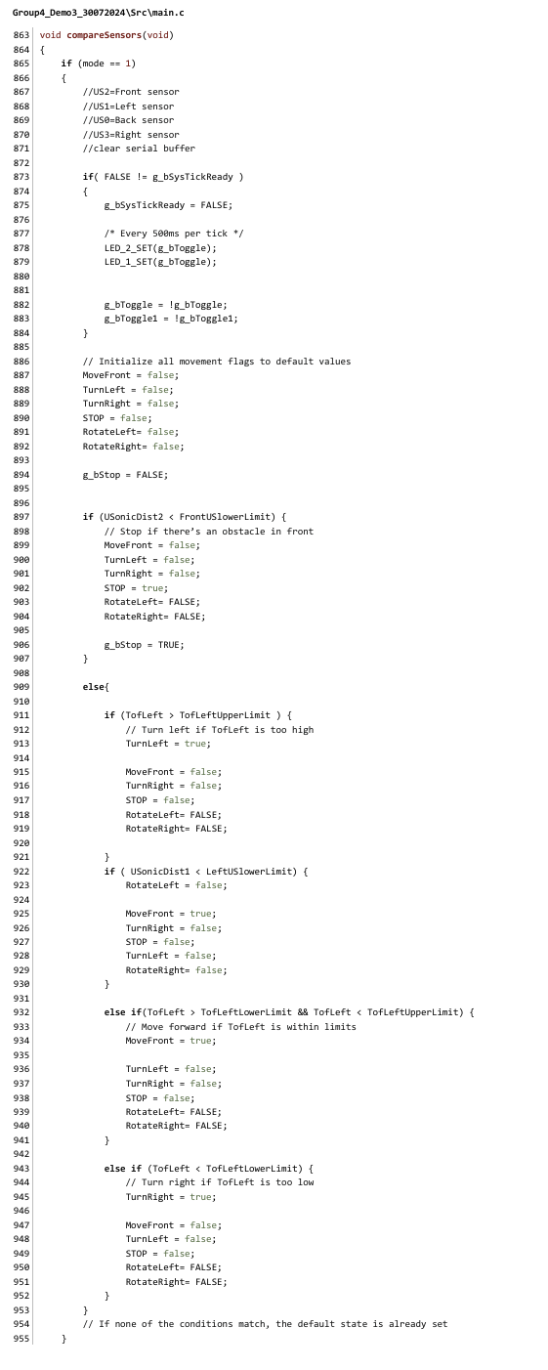
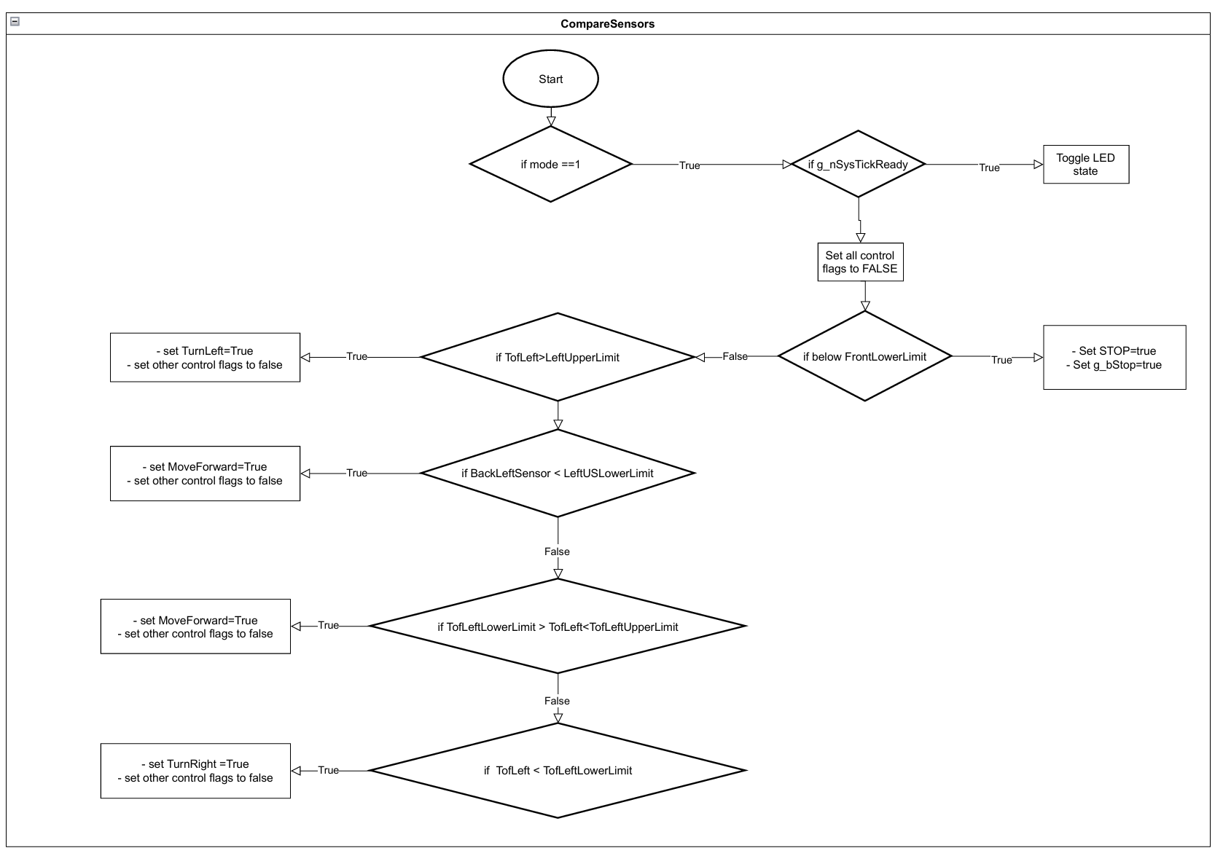
CompareSensors()

Slide 7
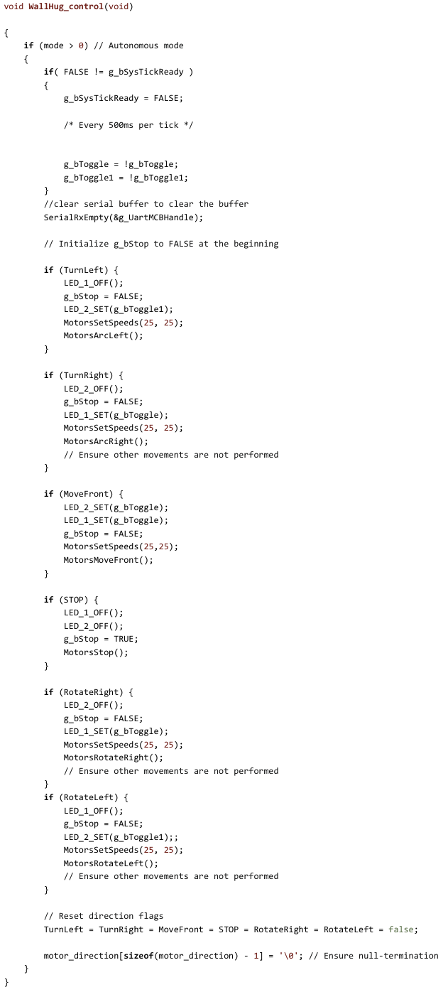
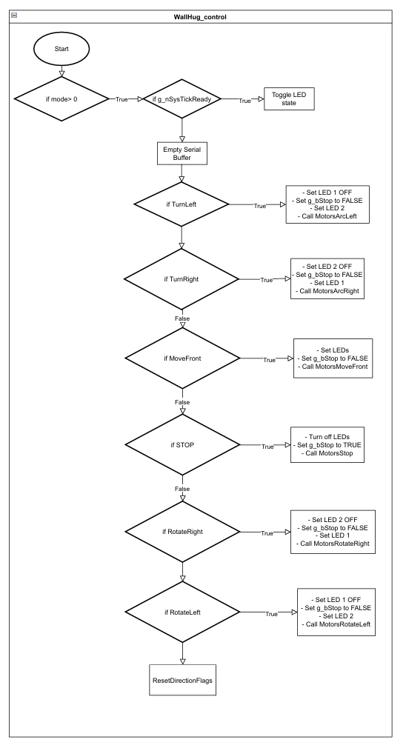
WallHug_control()

Slide 8
03
Testing

Slide 9
Testing

Slide 10
04
Conclusion

Slide 11
Reflection
Issue 1
When code is loaded, AMR move in circles on the spot
Solution: Re-measure distance of AMR to wall and adjust ToF value condition
Issue 2
MCB does not function properly even after conducting various unit testings and troubleshooting.
Solution: Replaced MCB board
Issue 3
Light Module does not function after troubleshooting but works on other groups AMR
Solution: Realised issue with baseboard due to pin 9 and 10 connectivity and replaced baseboard. Light Module works as intended thereafter.

Slide 12
Lessons Learnt
Only covered shoes should be worn in lab
Proper time management skills
Ensure Proper wire management
Ensure code variables and functions are defined properly

